Slide 1
Computer Organization and Design Assembly & Simulation
Montek Singh
Feb 22, 2016
Lecture 6

Slide 2
Today
Assembly programming
structure of an assembly program
assembler directives
data and text segments
allocating space for data
MIPS assembler: MARS
development environment
A few coding examples
self-study

Slide 3
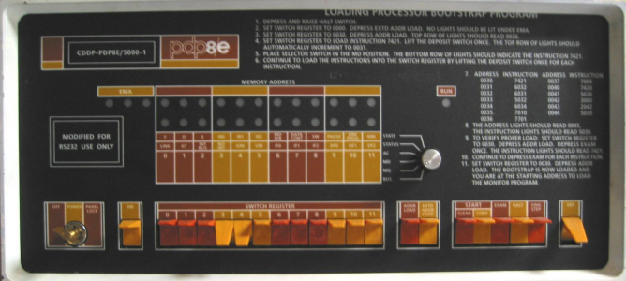
What is an Assembler?
A program for writing programs
Machine Language:
1’s and 0’s loaded into memory. (Did anybody ever really do that?)
Assembly Language:
Front panel of a classic PDP8e. The toggle switches were used to enter machine language.
.globl main
main:
subu $sp, $sp, 24 sw $ra, 16($sp) li $a0, 18 li $a1, 12 li $a2, 6 jal tak
move $a0, $v0
ASM
01101101
11000110
00101111
10110001
.....
STREAM of bits to be loaded into memory
Symbolic
SOURCE
text file
ASSEMBLER
Translator
program
Binary
Machine
Language
Assembly: A Symbolic LANGUAGE for representing strings of bits
Assembler: A PROGRAM for translating Assembly Source to binary

Slide 4
Assembly Source Language
An Assembly SOURCE FILE contains, in symbolic text, values of successive bytes to be loaded into memory... e.g.
.data 0x00000000
.byte 1, 2, 3, 4
.byte 5, 6, 7, 8
.word 1, 2, 3, 4
.asciiz "Comp 411"
.align 2
.word 0xfeedbeef
.text 0x00003000
Specifies address for start of data below
Four byte values
Another four byte values
Four word values (each is 4 bytes)
A zero (NULL) terminated ASCII string
Align to next multiple of 2²
A hex-encoded word value
Specifies address for start of program text
Resulting memory dump:
[0x00000000] 0x04030201 0x08070605 0x00000001 0x00000002
[0x00000010] 0x00000003 0x00000004 0x706d6f43 0x31313420
[0x00000020] 0x00000000 0xfeedbeef 0x00000000 0x00000000
Notice the byte ordering. This MIPS is “little-endian” (The least significant byte of a word or half-word has the lowest address)
Notes:
Resulting memory dump
Left hand size is the memory address, every location is four bytes long each resulting grouping is a 4 byte number
For the first, 01 is least significant byte, 02 03 04 where 04 is the most significant byte
0x706d6f43 is the start of Comp 411, the 0x00000000 is the null charcter that terminates everything
Align 2 means move to the next boundary, you move bytes until you reach an address that is a multiple of 4, which is why it skips 0x000000000

Slide 5
Assembler Syntax
Assembler DIRECTIVES = Keywords prefixed with ‘.’
Control the placement and interpretation of bytes in memory
.data <addr> Subsequent items are considered data .text <addr> Subsequent items are considered instructions .align N Skip to next address multiple of 2^{N}
Allocate Storage
.byte b₁, b₂, …, b_{n} Store a sequence of bytes (8-bits) .half h₁, h₂, …, h_{n} Store a sequence of half-words (16-bits) .word w₁, w₂, …, w_{n} Store a sequence of words (32-bits) .ascii “string” Stores a sequence of ASCII encoded bytes .asciiz “string” Stores a zero-terminated string .space n Allocates n successive bytes
Define scope
.globl sym Declares symbol to be visible to other files .extern sym size Sets size of symbol defined in another file (Also makes it directly addressable)
Notes:
.word stores a sequence of 32 bit integers

Slide 6
More Assembler Syntax
Assembler COMMENTS
All text following a ‘#’ (sharp) to the end of the line is ignored
Assembler LABELS
Labels are symbols that represent memory addresses
labels take on the values of the address where they are declared
labels can be for data as well as for instructions
Syntax: <start_of_line><label><colon>
.data 0x80000000
item: .word 1 # a data word
.text 0x00010000
start: add $3, $4, $2 # an instruction label
sll $3, $3, 8 andi $3, $3, 0xff
beq ..., ..., start
Notes:
Item: .word 1 is the equivalent of saying int item = 1
.data tells the assembler that the space in memory is startings at 0x80…

Slide 7
Even More Assembler Syntax
Assembler PREDEFINED SYMBOLS
Register names and aliases
$0-$31, $zero, $v0-$v1, $a0-$a3, $t0-$t9, $s0-$s7, $at, $k0-$k1, $gp, $sp, $fp, $ra
Assembler MNEMONICS
Symbolic representations of individual instructions
add, addu, addi, addiu, sub, subu, and, andi, or, ori, xor, xori, nor, lui, sll, sllv, sra, srav, srl, srlv, div, divu, mult, multu, mfhi, mflo, mthi, mtlo, slt, sltu, slti, sltiu, beq, bgez, bgezal, bgtz, blez, bltzal, bltz, bne, j, jal, jalr, jr, lb, lbu, lh, lhu, lw, lwl, lwr, sb, sh, sw, swl, swr, rfe
not all implemented in all MIPS versions
Pseudo-instructions (mnemonics that are not instructions)
abs, mul, mulo, mulou, neg, negu, not, rem, remu, rol, ror, li, seq, sge, sgeu, sgt, sgtu, sle, sleu, sne, b, beqz, bge, bgeu, bgt, bgtu, ble, bleu, blt, bltu, bnez, la, ld, ulh, ulhu, ulw, sd, ush, usw, move,syscall, break, nop
not real MIPS instructions; broken down by assembler into real ones
Notes:
Pseudo-instructions are instructions you can type into the assembler and it converts it to real instructions

Slide 8
A Simple Programming Task
Add the numbers 0 to 4 …
10 = 0 + 1 + 2 + 3 + 4
Program in “C”:
Now let’s code it in ASSEMBLY
int i, sum;
main() {
sum = 0;
for (i=0; i<5; i++)
sum = sum + i;
}

Slide 9
Assembly Code: Sum.asm
Next we write ASSEMBLY code using instr mnemonics
A common convention, which originated with the ‘C’ programming language, is for the entry point (starting location) of a program to named “main”.
.text 0x3000
.globl main
main:
add $8,$0,$0 # sum = 0
add $9,$0,$0 # for (i = 0; ...
loop:
add $8,$8,$9 # sum = sum + i;
addi $9,$9,1 # for (...; ...; i++
slti $10,$9,5 # for (...; i<5;
bne $10,$0,loop
end: ... # need something here to stop!
$8 will have sum
$9 will have i
Bookkeeping:
1) Register $8 is allocated as the “sum” variable
2) Register $9 is allocated as the “i” variable
We will talk about how to exit a program later

Slide 10
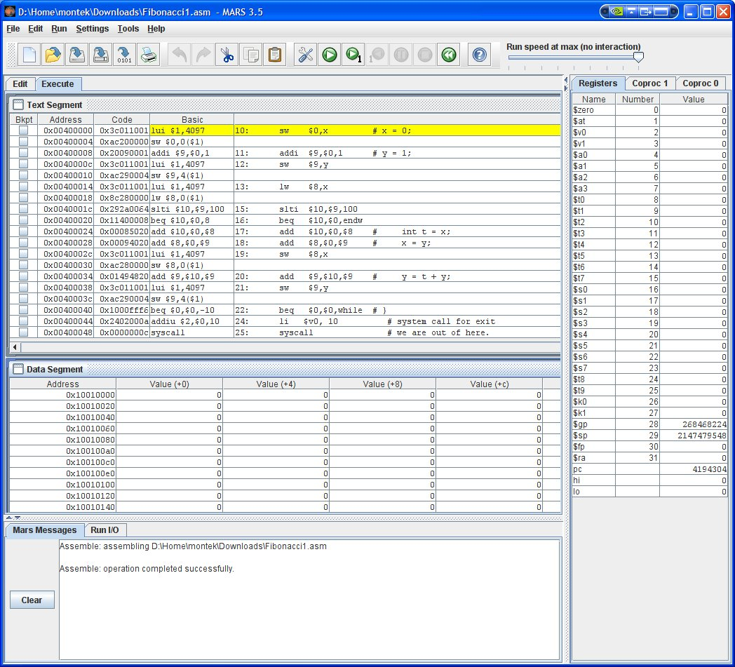
MARS
MIPS Assembler and Runtime Simulator (MARS)
Java application
Runs on all platforms
Links on class website
Download it now!

Slide 11
A Slightly More Challenging Program
Add 5 numbers from a list …
sum = n₀ + n₁ + n₂ + n₃ + n₄
In “C”:
Once more… let’s code it in assembly
int i, sum;
int a[5] = {7,8,9,10,8};
main() {
sum = 0;
for (i=0; i<5; i++)
sum = sum + a[i];
}

Slide 12
Variable Allocation
Let’s put variables in memory locations…
… rather than registers
This time we add the contents of an array
Note: “.word” also works for an array of words
allows us to initialize a list of sequential words in memory
label represents the address of the first word in the list, or the name of the array
does this remind you of how C treats arrays as pointers?!
Note: “.space 4” means 4 bytes uninitialized
“.word” needs initial value
.data 0x0
sum: .space 4
i: .space 4
a: .word 7,8,9,10,8
Arrays have to be in memory. Why?

Slide 13
The New Code: SumArray.asm
Note the small changes:
Assembler replaces sum with 0x0, i with 0x4, and a with 0x8 (see previous slide)
.text 0x3000
.globl main
main:
sw $0,sum($0) # sum = 0;
sw $0,i($0) # for (i = 0;
lw $9,i($0) # bring i into $9
lw $8,sum($0) # bring sum into $8
loop:
sll $10,$9,2 # covert "i" to word offset
lw $10,a($10) # load a[i]
add $8,$8,$10 # sum = sum + a[i];
sw $8,sum($0) # update variable in memory
addi $9,$9,1 # for (...; ...; i++
sw $9,i($0) # update memory
slti $10,$9,5 # for (...; i<5;
bne $10,$0,loop
end: ... # code for exit here

Slide 14
A couple of shortcuts
Can skip the immediate or register field of lw/sw
assumed to be zero
lw $8,sum ... is the same as … lw $8,sum($0)
lw $8,($10) ... is the same as … lw $8,0($10)
assembler will fill in for you
Also, can optimize code by eliminating intermediate updates in memory
(next slide)

Slide 15
A couple of shortcuts
Also, can optimize code by eliminating intermediate updates in memory
a good C compiler will do that automatically for you
main:
add $9,$0,$0 # i in $9 = 0
add $8,$0,$0 # sum in $8 = 0
loop:
sll $10,$9,2 # covert "i" to word offset
lw $10,a($10) # load a[i]
add $8,$8,$10 # sum = sum + a[i];
addi $9,$9,1 # for (...; ...; i++
slti $10,$9,5 # for (...; i<5;
bne $10,$0,loop
sw $8,sum($0) # update sum in memory
sw $9,i($0) # update i in memory
end: ... # code for exit here

Slide 16


A Coding Challenge
What is the largest Fibonacci number less than 100?
Fibonacci numbers: F_{i+1} = F_{i} + F_{i-1} F₀ = 0 F₁ = 1
0, 1, 1, 2, 3, 5, 8, 13, 21, 34, …
In “C”:
int x, y;
main() {
x = 0;
y = 1;
while (y < 100) {
int t = x;
x = y;
y = t + y;
}
}

Slide 17
MIPS Assembly Code: Fibonacci.asm
In assembly
.data 0x0
x: .space 4
y: .space 4
.text 0x3000
.globl main
main:
sw $0,x # x = 0;
addi $9,$0,1 # y = 1;
sw $9,y
lw $8,x
while: # while (y < 100) {
slti $10,$9,100
beq $10,$0,endw
add $10,$0,$8 # int t = x;
add $8,$0,$9 # x = y;
sw $8,x
add $9,$10,$9 # y = t + y;
sw $9,y
j while # }
endw:
# code for exit here
# answer is in x

Slide 18
Coming Up…
Parameterized Programs
Procedures
Stacks
MIPS procedure linkage conventions

